Slide 1
Berkeley DB: The Good, The Bad and the Ugly
Margo Seltzer
Failed Aspirations in Database Systems
August 28, 2017
Notes:
To be clear: I am talking as an academic about lessons *I* learned while doing Berkeley DB – as a grad student, as a company (Sleepycat), as an architect at Oracle. But this is not an Oracle presentation. This is an academic presentation.
What this talk is about: BDB was not a failed aspiration; it backed most of the first generation web services and is still in use today 20+ years later. Our Java product backs the Oracle NoSQL Database.
But, there were painful lessons learned along the way – the kinds of lessons that are easy to repeat, so here goes…

Slide 2
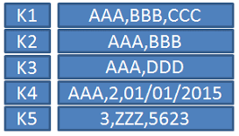
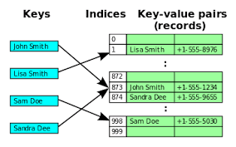
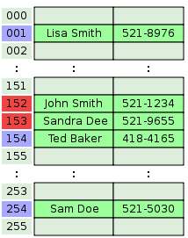
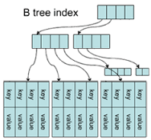
A Refresher: What is Berkeley DB?
Key-Value Store
Notes:
Basically a key-value store
That’s a common API wrapped around a collection of access methods

Slide 3
A Refresher: What is Berkeley DB?
ACIDACIDACIDACIDACIDACIDACIDACIDACIDACIDACIDACIDACIDACIDACIDACID
Key-Value Store
ACIDACIDACIDACIDACIDACIDACIDACIDACIDACIDACIDACID
ACIDACIDACIDACIDACIDACIDACIDACIDACIDACIDACIDACID
ACIDACIDACIDACIDACIDACIDACIDACIDACIDACIDACIDACIDACIDACIDACIDACID
Notes:
Providing ACID (and weaker) transactions

Slide 4
A Refresher: What is Berkeley DB?
PAXOSPAXOSPAXOSPAXOSPAXOSPAXOSPAXOSPAXOSPAXOSPAXOSPAXOSPAXOS
SQL
XML
PAXOSPAXOSPAXOSPAXOSPAXOSPAXOSPAXOSPAXOS
PAXOSPAXOSPAXOSPAXOSPAXOSPAXOSPAXOSPAXOS
DB
PAXOSPAXOSPAXOSPAXOSPAXOSPAXOSPAXOSPAXOSPAXOSPAXOSPAXOSPAXOS
Notes:
And you can access it in a variety of ways: SQL, XML, Native DB query API

Slide 5
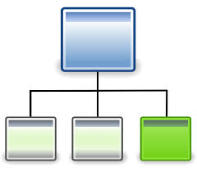
A Refresher: What is Berkeley DB?
PAXOSPAXOSPAXOSPAXOSPAXOSPAXOSPAXOSPAXOSPAXOSPAXOSPAXOSPAXOS
SQL
XML
PAXOSPAXOSPAXOSPAXOSPAXOSPAXOSPAXOSPAXOS
PAXOSPAXOSPAXOSPAXOSPAXOSPAXOSPAXOSPAXOS
DB
PAXOSPAXOSPAXOSPAXOSPAXOSPAXOSPAXOSPAXOSPAXOSPAXOSPAXOSPAXOS
Notes:
And it all embeds inside an application (i.e., it’s a library)
Or in marketing speak:
Reliable, scalable, flexible, fast data management
Library that links directly into your application
Enterprise database functionality with:
A fraction of the footprint
Hands-off administration
Programmatic configuration and management
Ability to select which features you use
Data management hidden in an application

Slide 6
A Brief History
1991: hash built to replace dbm, ndbm, hsearch.
1992: add B-tree access method and place hash and btree under uniform db interface.
1994: db1.85 released with 4.4 BSD.
1996: db1.86 released (largely for kerberos).
1996: Sleepycat Software formed to produce transactional/recoverable Berkeley DB.
1997: db2.0 released by Sleepycat Software.
1999: db3.0 released by Sleepycat Software.
2001: db4.0 released by Sleepycat Software.
2006: Sleepycat Software acquired by Oracle.
Notes:
Context: freeing up UNIX from AT&T license
Lots of interim 4.X releases
Db3: Object-oriented API
Db4: Replication
4.1, 4.2, 4.3, 4.4 (talk about the fact that it gets harder to make changes warranted by a first digit version number).

Slide 7
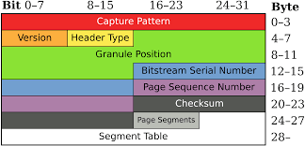
Three Lessons
P
A
I
NOT
XML and XQuery: The Cure for All Data
Notes:
Page formats (Margo is stubborn)
API DESIGN: Per-thread data structures, registration, and how do you block on mutexes
New products and/or APIs (you’ve already heard about a couple of XML disasters…let’s talk about one more)

Slide 8
Page Format: History
Notes:
A brief bit of history:
I wrote a hash package while at Berkeley (hash) → replacing AT&T code
Then Mike Olson wrote a B-tree, which Keith Bostic “tweaked” and released under the same API as the hash package as db1.85
The Umich LDAP team picked it up
Umich LDAP -> Netscape
Netscape wanted a transactional version – Keith and I started Sleepycat

Slide 9
Page Format: db.185 Hash
N
k1off
d1off
k2off
d2off
Remaining offsets …
Free space
Other keys/datas
Key 2
Data 1
Key 1
Notes:
Now before you all go start laughing, I just want to remind you that this page format was designed circa 1988; memory was tiny…
N is the number of items on a page
ITEMS ARE UNORDERED – just put them in the page in the order that they came in – after all, this is a hash access method …
So, how do you know how large items are? You subtract the two offsets…
This means that you have to shuffle things for insert/delete
This remained largely unchanged as we added txn support …

Slide 10
Page Format: db.2.0
lsn
pgno
ppgno
npgno
nentries
f_offset
Free space
Etc …
Data-struct-2
Key-struct-1
Notes:
OK, so now it’s 1996 and we’re off building product.
We have a common page header among all our access methods.
It adds some meta-data for transactions … stuff like an LSN, page numbers …
And because we’re now going to support big items and stuff like that, we reference structures on the page rather than the values themselves…
We are so close, and then …

Slide 11
Page Format: db.2.0
I need lengths in my item structures and I need to represent duplicates data items as individual key/data pairs
Alors! I can’t waste all that space! I don’t need no stinkin’ lengths; my duplicates all pack into a single data item! And my code is already working!
Notes:
Keith and I go off transactionalizing our own access methods (Margo = hash; Keith = Btree/Recno).
And Keith needs some more meta-data…

Slide 12
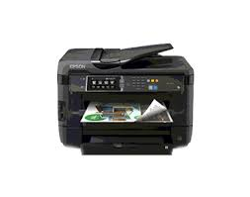
Page Formats: Consequences
Notes:
We ended up with multiple:
Page formats
Print routines
Recovery routines
Scavenger routines …
UNTIL …
In __ham_46_hash (version 8 to verion 9) – sorted the entries (2007)
Merged blob handling 2015

Slide 13
Page Formats: Lessons
Notes:
Sunk costs are irrelevant! -- A small change in 1997 would have saved TONS of engineering effort over the next 20 years; If you don’t have time to get it right now, when will you have time?
When you find yourself in a hole, stop digging!

Slide 14
API Design: History
P
A
I
Notes:
The Problem: Databases are accessed by multiple transactions.
In 1997 – this usually meant MULTIPLE PROCESSES (not threads) – Pthreads was just standardized in 1995; not widely available.
So, how do you make processes wait for each other?

Slide 15
Making Processes Wait
P
A
I
Process 1
Process 2
Process 3
Notes:
You can wait on a resource by allocating a lock for each resource.
You can wait on a process by allocation a lock per process (or thread)
It should seem obvious that you’re going to have more resources than processes, so you should have a lock per process.
It should also seem obvious that if you have a lock per process, you can control the order in which you release locks.
So, it should seem obvious which way you’d go …

Slide 16
Lock per Resource!
P
A
I
Notes:
So why did we do something bone-headed?
Two main reasons: When we talk about locking (we = academics or anyone else for that matter), we couple and conflate the locking of a resource with the waiting for that resource. BUT – those are actually two entirely different things. One is a data structure and one is a scheduling primitive.
Second: Our major customer (Netscape) wanted/demanded to be able to conjure up threads without having to call any initialization scheme – this was a bad reason.

Slide 17
Lock per Resource!
P
A
I
Process 1
Process 2
Process 3
Notes:
Let’s look at that coupling of LOCKING and SCHEDULING
BREAK THE LOCK INTO TWO PARTS – the blocking part that goes on the Process

Slide 18
Lock per Resource!
P
A
I
holds
Process 1
X
R
Process 2
wants
R
wants
Process 3
Notes:
And the queuing part that is associated with an object.
So, let’s say that process 2 now wants a Read lock
We create another element that references P2’s lock
And hook it in
If P3 also wants a read lock, we create another entry
And hook it in

Slide 19
Lock per Resource!
P
A
I
Process 1
X
R
Process 2
wants
holds
R
wants
holds
Process 3
Notes:
Now let’s say that P1 release its lock
We traverse the list, waking up everyone who needs to be wakened:

Slide 20
Consequences
P
A
I
Notes:
Gazillions of locks – everywhere!
Wastes cycles because everyone wakes up when the resource is available even if there is a long queue
Cleaning up after dead processes/threads is more painful than it needs to be

Slide 21
Lessons
P
A
I
Notes:
This sounds like it’s about data structure design and it kind of is, but it’s really about API design.
Had we designed thread-local storage in up front, and encoded it in the API, we would have solved this problem and MANY MANY MANY others.
So, your customers may tell you what they want, but sometimes, you need to give them what they need.
Stop conflating queuing and scheduling!

Slide 22
XML: History
NOT
XML and XQuery: The Cure for All Data
Notes:
I see I’m not the first to talk about XML …
When you are a small database company, one thing you do every day is ask, “What should we be doing to grow business and NOT compete with Oracle.”
[Companies whose basic premise is, “We’ll compete with Oracle” always baffle me.]
So in 2001, a couple of “really smart guys” – folks we’ve worked with before and really like – approach us about using BDB as an XML store …
XML is kind of in the air; the big guys are talking about it, but there aren’t a ton of products out there.

Slide 23
Berkeley DB XML
NOT
XML and XQuery: The Cure for All Data
Storage, schema and query layer built on top of Berkeley DB
Flexible XML-based storage
Documents are stored in containers.
Query documents using XQuery 1.0.
Core competency
Berkeley DB
XML
Berkeley
DB
Document
Parser
Query
Parser
Query
Planner
Query
Optimizer
All the value add
Notes:
What’s wrong with this picture?
What is our core competency? STORAGE
And what is this product about? ! Storage…
That should have been a sign …

Slide 24
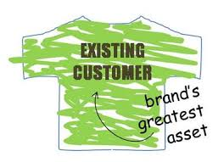
And what about customers
NOT
XML and XQuery: The Cure for All Data
New Customers?

Slide 25
XML Lessons
NOT
XML and XQuery: The Cure for All Data
Great Products
Great People
Notes:
Know your core competency

Slide 26
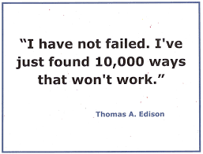
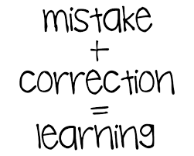
Parting Thoughts
Notes:
I really want to thank Spyros, Justin, and Andy for putting this workshop together (and am truly sorry and disappointed that I couldn’t be there in person).
[This is a bit of preaching to the choir, but I’m going to say it anyway.]
How can we expect students (and young engineers) to learn from their mistakes if we never talk about our own?
Some lessons are *very* expensive to learn – we owe it to the community to some how get those out there!

